Slide 1
Machine Learning (CS 667)
STACKED ENSEMBLE TECHNIQUE
PRESENTER
Kanika warman (mf1513)

Slide 2
CONTENTS
Paper Introduction
Technique used in the paper
Implementation of Paper
Suggestions/Modifications
Comparison

Slide 3
Paper Introduction: An Improved Heart Disease Prediction Using Stacked Ensemble Method
This machine learning project focuses on implementing an already published paper available at: https://arxiv.org/pdf/2304.06015.pdf
The focus of this paper is to develop prediction algorithm using machine learning that could help in predicting heart diseases and other heart related ailments in humans.
The machine learning technique used in the paper focus on ‘Stacked Ensemble’ Technique.

Slide 4
As cardiac illness becomes increasingly common, data on the condition is getting more nonlinear, non-normal, association-structured, and complicated. As a result, forecasting heart illness is a major difficulty in medical data exploration, and clinicians find it extremely difficult to properly forecast heart disease diagnosis.
The paper have proposed an attempted solution to produce an outcome, and a superior prediction system to deal with the prediction problem.
Several studies have endeavored to use advanced approaches to analyze heart disease data. But they fail somewhere because of the techniques used:
If the bagging is not adequately represented in the ensemble approach, it might result in excessive bias and consequently under-fitting.
The boosting is also difficult to apply in real time due to the algorithm's increasing complexity.
On the other hand, the proposed approach in the paper may combine the skills of several high-performing models on a classification or regression job to provide predictions that outperform any single model in the ensemble while also being simpler to build.

Slide 5


ENSEMBLE techniques
Ensemble techniques are the methods that use multiple learning algorithms or models to produce one optimal predictive model.
The model produced has better performance than the base learners taken alone.
Ensemble techniques can be primarily classified into Bagging, Boosting, and Stacking.
This paper focuses on Stacked Ensemble Method, often referred to as stacking. It is implemented on the dataset that combines the predictions of multiple diverse models by training a meta-model on their outputs.
It leverages the strengths of individual models, creating a more robust and accurate predictor by learning how to best weigh and utilize the predictions of the base models.
This hierarchical approach enables the ensemble to capture complex patterns and enhance overall predictive performance.
However, it could be time and memory consuming if implemented with no-caution.

Slide 6
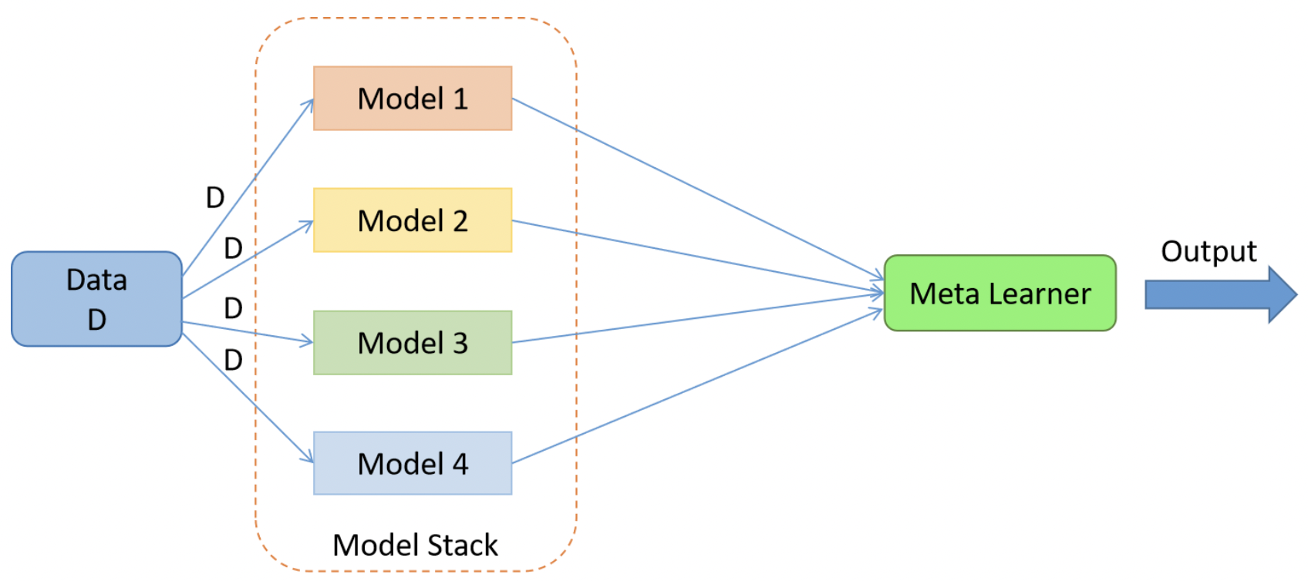
stacked ENSEMBLE
Stacked ensemble often considers heterogeneous weak learners, learns them in parallel, and combines them by training a meta-learner to output a prediction based on the different weak learner’s predictions.
A meta learner inputs the predictions as the features and the target being the ground truth values in data.
A generalization of this approach is replacing the linear weighted sum with Linear Regression (regression problem) or Logistic Regression (classification problem) to combine the predictions of the sub-models with any learning algorithm. This approach is called Stacking.
In stacking, an algorithm takes the outputs of sub-models as input and attempts to learn how to best combine the input predictions to make a better output prediction.
A variant of stacking is Multi-layer stacking, also known as stacked ensembling with multiple levels.
This involves training multiple layers of models where the predictions of the lower-level models serve as input features for the higher-level models. This hierarchical approach aims to capture complex relationships in the data, enhancing predictive performance by combining insights from multiple model layers.

Slide 7
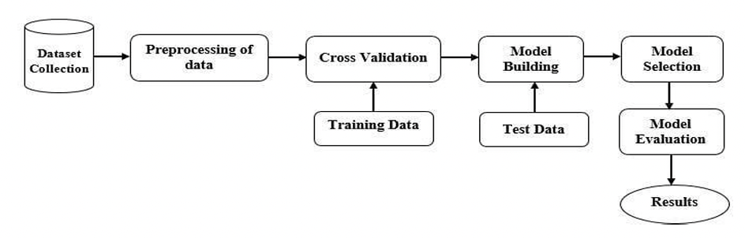
Implementation of the paper
The paper describes the following steps while performing the model training:
Data Collection
Pre-processing of Data
Cross Validation
Training Data
Model Building
Model Selection
Model Evaluation
Results

Slide 8
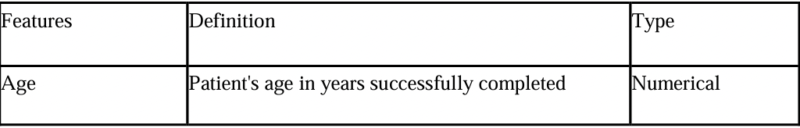
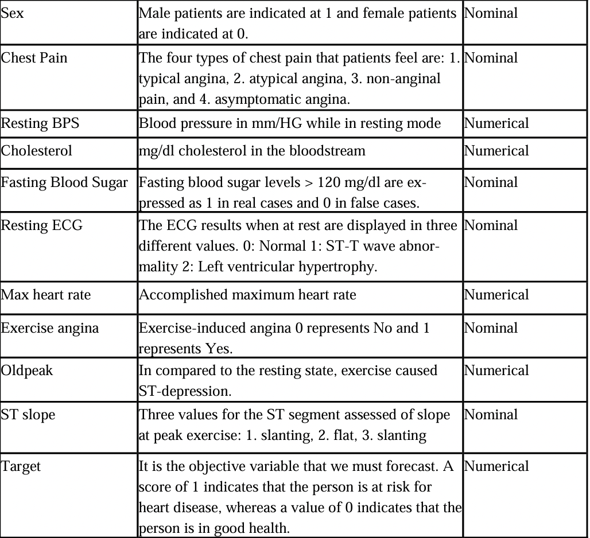
Paper implementation: Model training
Data Collection:
In this study, the Statlog, Cleveland, and Hungary dataset (three datasets combined into one) is used along with other datasets.
There are 1190 records in all, with 11 characteristics and one target variable.

Slide 9
Paper implementation: Model training
Data Pre-processing:
It should be noted that null or missing values are utilized to represent zero values. As a result, we must delete null values throughout the data preparation step.
use the z-score to identify and eliminate outliers.
Training:
Divide the data into two parts: training and testing, with 80/20 percentages.
Develop a model using cross-validation.
For a stacked ensemble technique, we stack all of the models such as RF, MLP, KNN, ETC, XGB, SVC, ADB, CART, and GBM.
We assess and compare our model to other models.

Slide 10
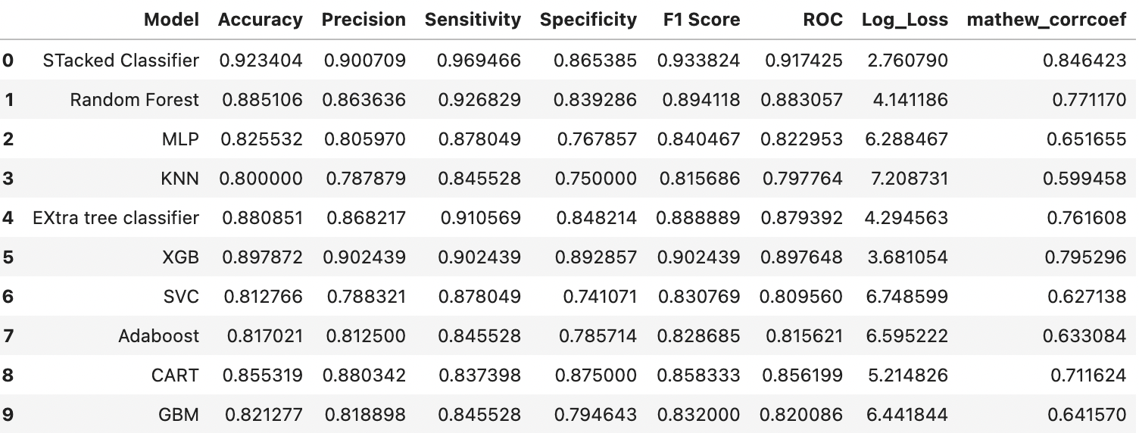
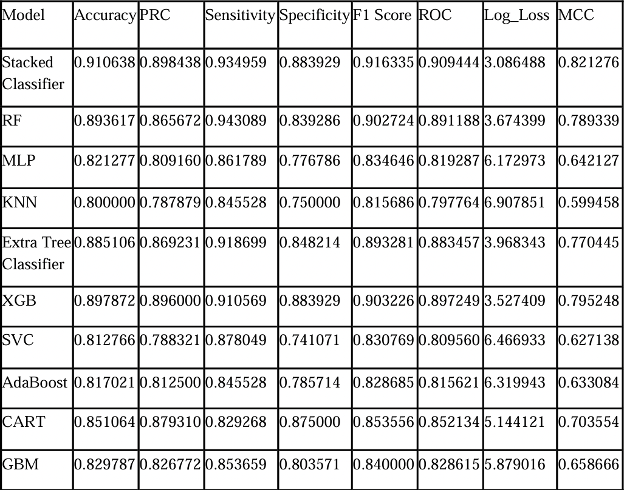
Paper implementation: results comparison

Slide 11
Modifications/ Suggestion
The paper used stacked ensemble Classifier to show an improved heart disease prediction method. The significance of prediction performance was examined using precision, ROC sensitivity, Specificity, F1 Score, Log Loss, and MCC.
To identify if a person has a heart problem, machine learning technique was applied and discovered that the enhanced stacked ensemble approach provides better accuracy than previous methods.
To further enhance and better the prediction results, we could incorporate the below methods:
1. Use feature selection to focus on attributes that contribute more to the target variable decision.
2. Evaluate all the base models and use only the ones that have better result for the target variable compared to others.
3. Use 2-level stacking

Slide 12
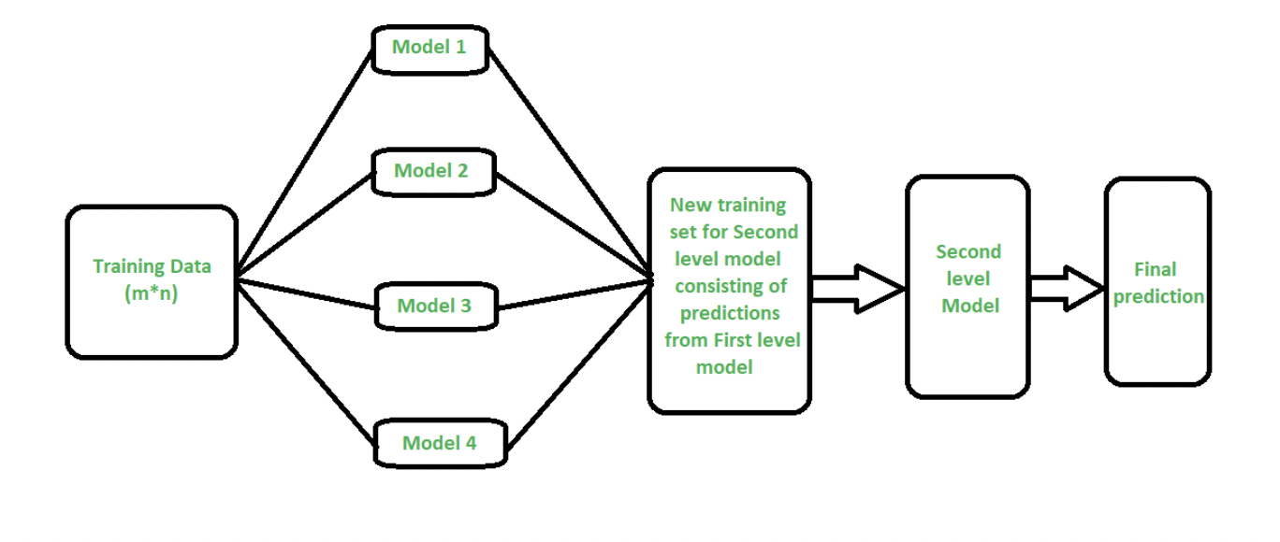
Modifications/ Suggestions: Multi-level stacking
Two-level stacking is an ensemble learning technique that involves training multiple diverse base models in the first level and using their predictions to create a stacked dataset.
In the second level, a meta-model is trained on the stacked predictions to make the final predictions.
This approach leverages the collective strength of diverse models in the first level and the meta-model's ability to capture complex relationships in the ensemble's predictions, often leading to improved overall performance.

Slide 13
Implementing modifications
To implement the suggested modifications in the paper, focus was made on:
Use feature selection to identify key attributes and remove the remaining from the dataset.
For a stacked ensemble technique, we stack all the models such as RF, MLP, KNN, ETC, XGB, SVC, ADB, CART, and GBM and evaluate their performances using k-fold technique.
Choose only the top performing models for stacking.
Perform 2-level stacking using selected base models and meta training.
Assess and compare the model to previous models.

Slide 14
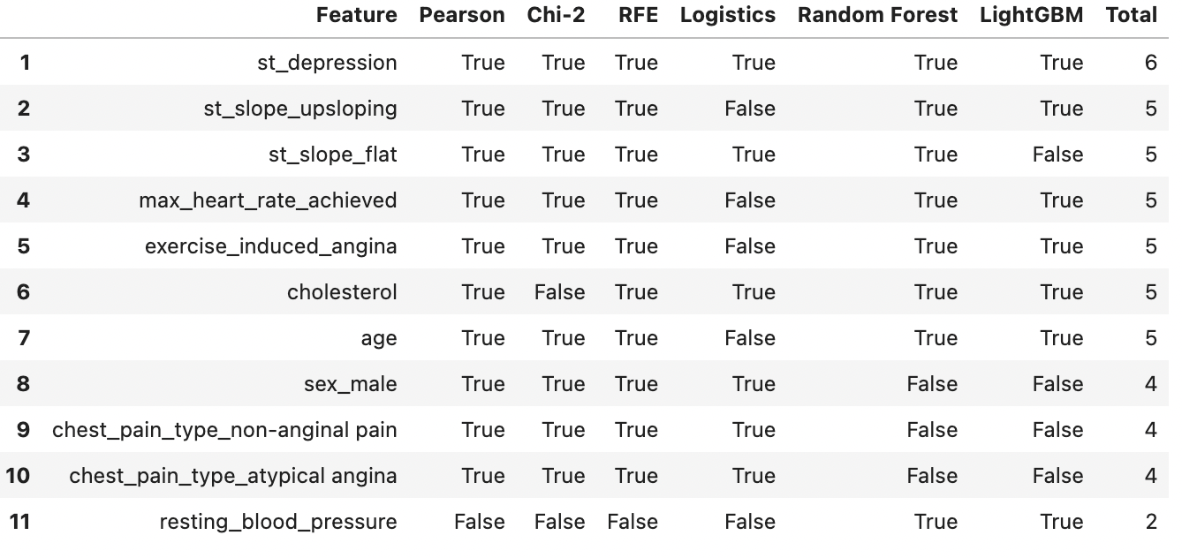
Implementing modifications
Different feature selection methods have been used and the results of them have been combined at the end to see the results.
Correlation-based Feature Selection: The cor_selector function uses correlation with the target variable (y) to select the top features based on their correlation scores.
Chi-Square Feature Selection: The chi_selector function uses the chi-squared statistical test to select features that are most likely to be independent of the target variable (y).
Recursive Feature Elimination (RFE): The rfe_selector function uses Recursive Feature Elimination with logistic regression as the base estimator to iteratively eliminate the least important features.
SelectFromModel method: This method allows you to use the coefficients of a trained model to select the most important features.
Using multiple methods and comparing their results can provide a more robust understanding of which features are likely to be informative for the given predictive modeling task.

Slide 15
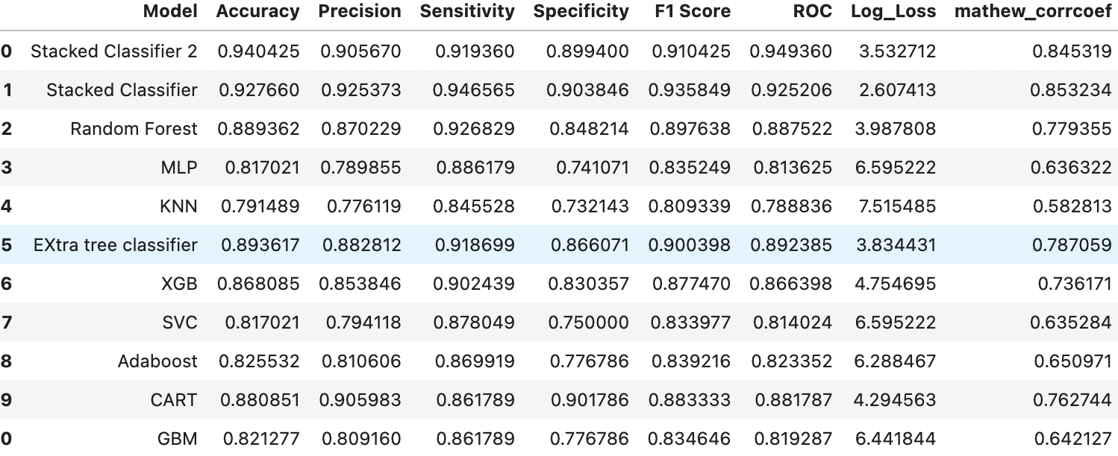
Evaluate the performance of suggested model training
New Suggested Model with features selection and 2 Layer stacked Ensemble
Paper implemented model with 1 layer stack ensemble

Slide 16
Conclusion & Future Recommendation
Feature selection is crucial for enhancing model efficiency and interpretability by identifying relevant variables.
When combined with multi-layered stacking, it further refines the model's predictive power. By selecting the most informative features, the stacking ensemble can focus on key patterns and relationships, potentially improving generalization to new data.
Feature selection helps in eliminating noise and redundancy, enhancing the ensemble's ability to capture complex relationships. Multi-layered stacking leverages diverse base models, mitigating biases and producing more robust predictions. This combined approach contributes to higher accuracy, precision, and overall model effectiveness.
While stacking is a powerful technique, caution is needed to avoid overfitting, especially when using multiple layers of models. It's essential to strike a balance between model complexity and generalization.
Additionally, stacking may be computationally intensive, requiring careful consideration of resource constraints.
Interpretability may also be a challenge as the ensemble becomes more complex.
Practitioners should validate results rigorously and be mindful of the potential for increased model complexity leading to diminished interpretability and longer training times.

Slide 17
REFERENCES
https://www.analyticsvidhya.com/blog/2021/08/ensemble-stacking-for-machine-learning-and-deep-learning/
https://www.geeksforgeeks.org/stacking-in-machine-learning/

Slide 18
THANK YOU!

